Slide 1
Initiating Git Repositories

Slide 2
Introduction to Version Control
What is version control?
Importance in software development
Centralized vs Distributed systems
Role of Git in modern workflows
Version control systems track changes to files over time.
They allow collaboration, rollback to previous versions, and maintain integrity.
Git is a distributed system where each user has a full repository copy
Notes:
Version control systems track changes to files over time. They allow collaboration, rollback to previous versions, and maintain integrity. Git is a distributed system where each user has a full repository copy.

Slide 3
What is Git?
Distributed Version Control System
Efficient file tracking
Supports branching and merging
Open-source and widely adopted
Notes:
Git enables developers to track changes efficiently. It supports powerful branching and merging features, allowing parallel development.

Slide 4
Installing Git
Download from git-scm.com
Install on Windows/macOS/Linux
Verify with git --version
Set initial configuration
Notes:
After installation, verify Git using 'git --version'. Proper installation ensures command-line access to Git tools.

Slide 5
Installing Git
How to Install Git
You can download Git for free from git-scm.com.
Windows: Download and run the installer. Click "Next" to accept the recommended settings. This will install Git and Git Bash.
macOS: If you use Homebrew, open Terminal and type brew install git. Or, download the .dmg file and drag Git to your Applications folder.
Linux: Open your terminal and use your package manager. For example, on Ubuntu: sudo apt-get install git
Notes:
After installation, verify Git using 'git --version'. Proper installation ensures command-line access to Git tools.

Slide 6
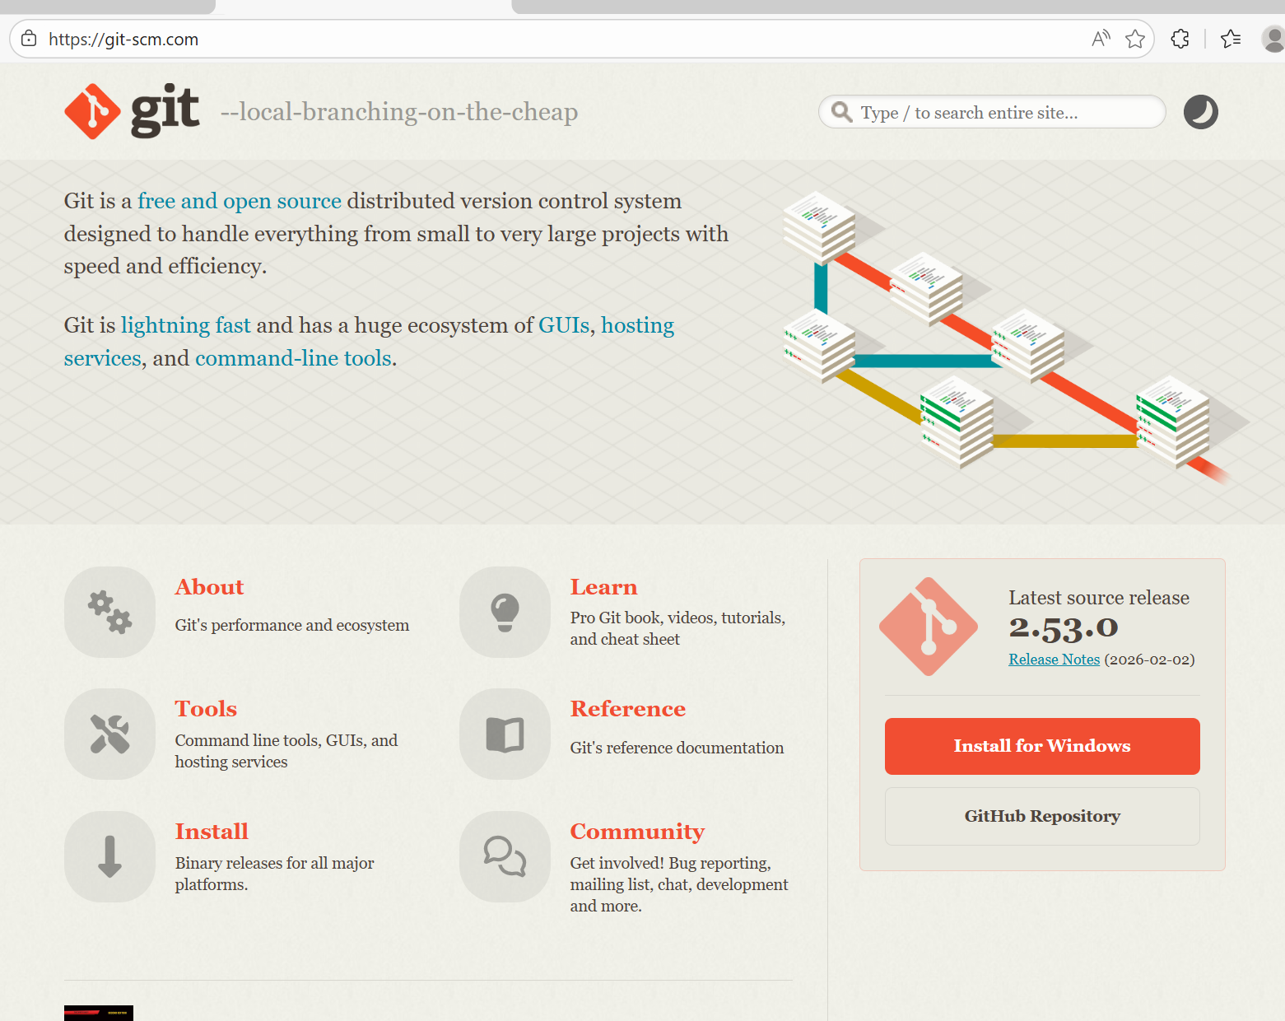
Installing Git
Notes:
After installation, verify Git using 'git --version'. Proper installation ensures command-line access to Git tools.

Slide 7
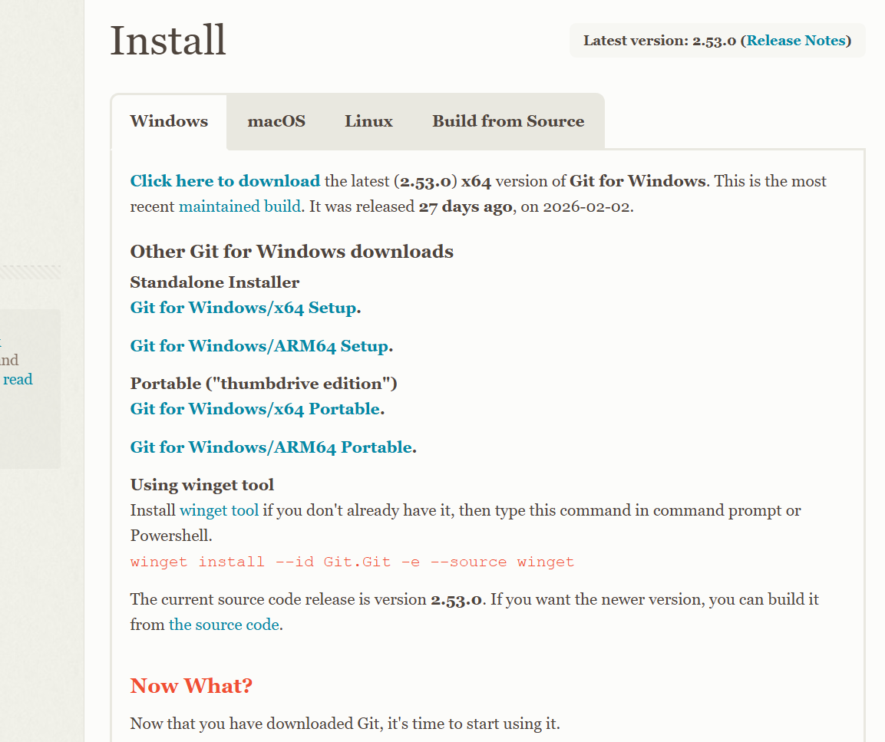
Installing Git
Notes:
After installation, verify Git using 'git --version'. Proper installation ensures command-line access to Git tools.

Slide 8
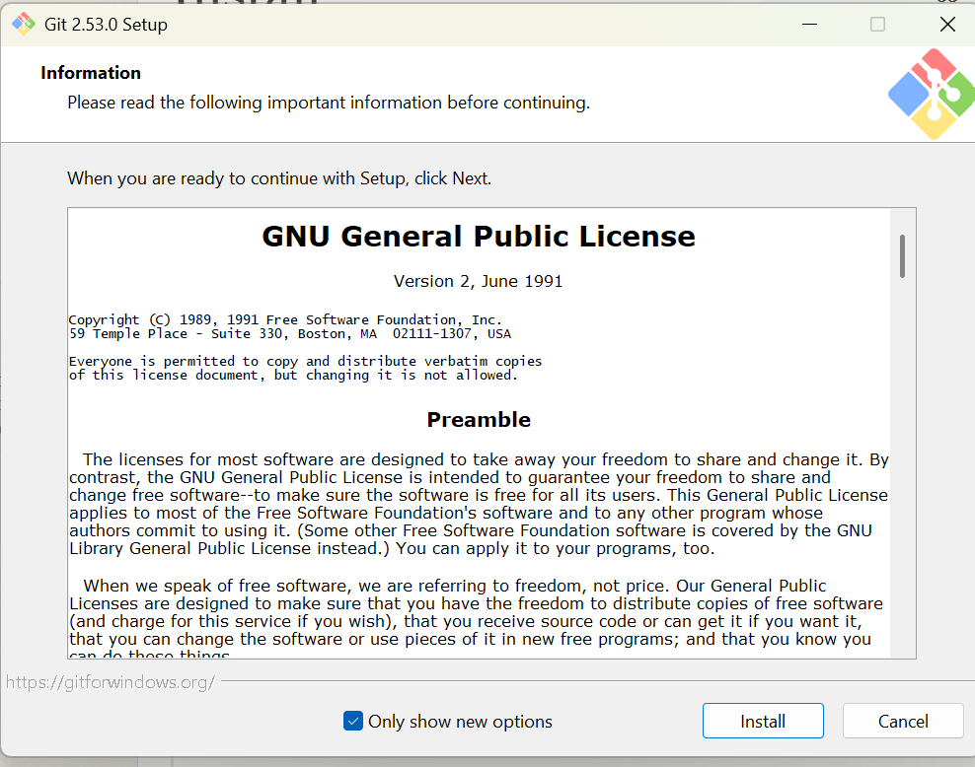
Installing Git
Notes:
After installation, verify Git using 'git --version'. Proper installation ensures command-line access to Git tools.

Slide 9
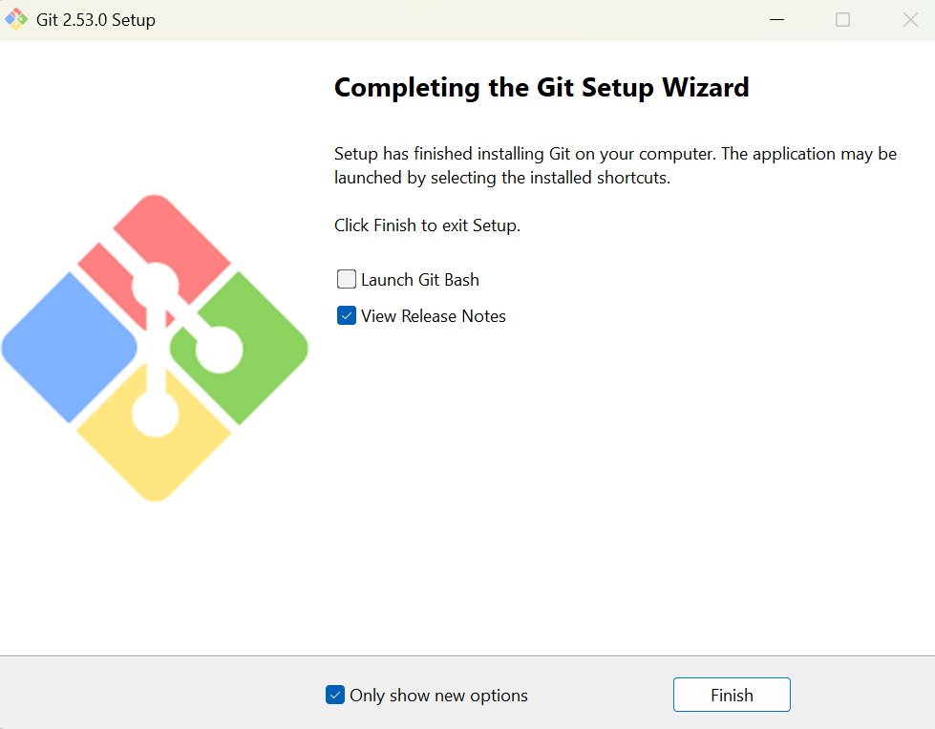
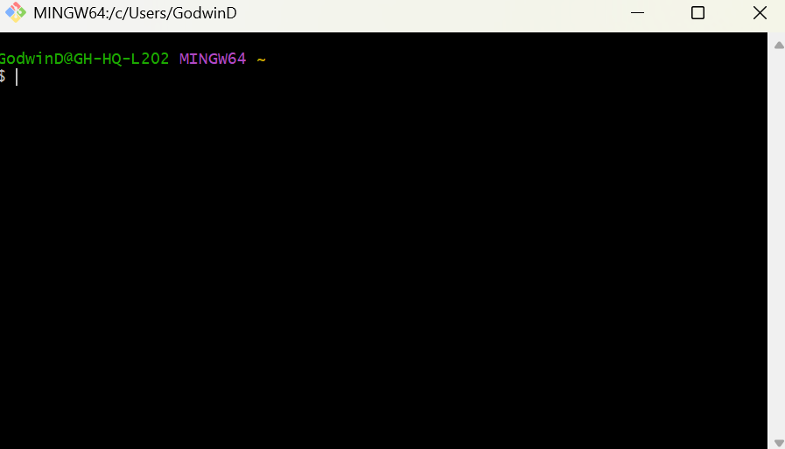
Installing Git
Notes:
After installation, verify Git using 'git --version'. Proper installation ensures command-line access to Git tools.

Slide 10
Installing Git
Git Bash
Git Bash is a terminal for Windows that lets you use Git commands.
Notes:
After installation, verify Git using 'git --version'. Proper installation ensures command-line access to Git tools.

Slide 11
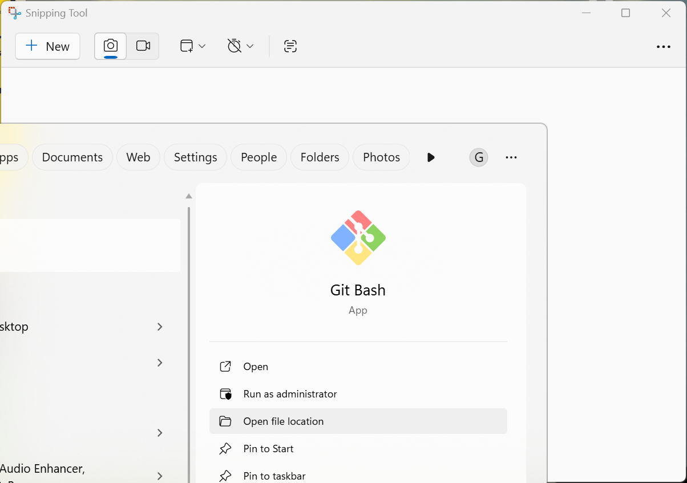
Configuring Git
Start Git Bush
Notes:
Use git config --global user.name and user.email to configure identity. These details appear in commit history.

Slide 12
Configuring Git
Set username
Set email address
Configure default editor
Check configuration using git config --list
Notes:
Use git config --global user.name and user.email to configure identity. These details appear in commit history.

Slide 13
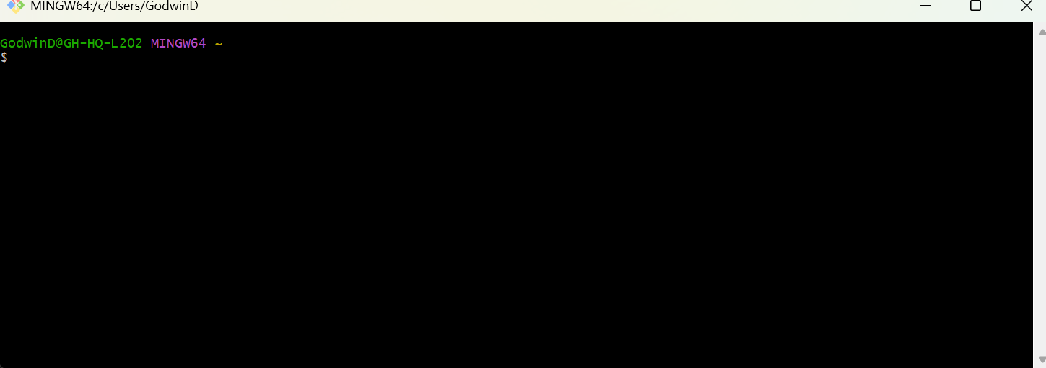
Configuring Git
Set username
Notes:
Use git config --global user.name and user.email to configure identity. These details appear in commit history.

Slide 14
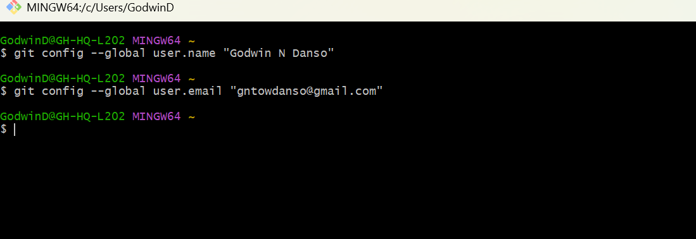
Configuring Git
Set username
Set email address
Notes:
Use git config --global user.name and user.email to configure identity. These details appear in commit history.

Slide 15
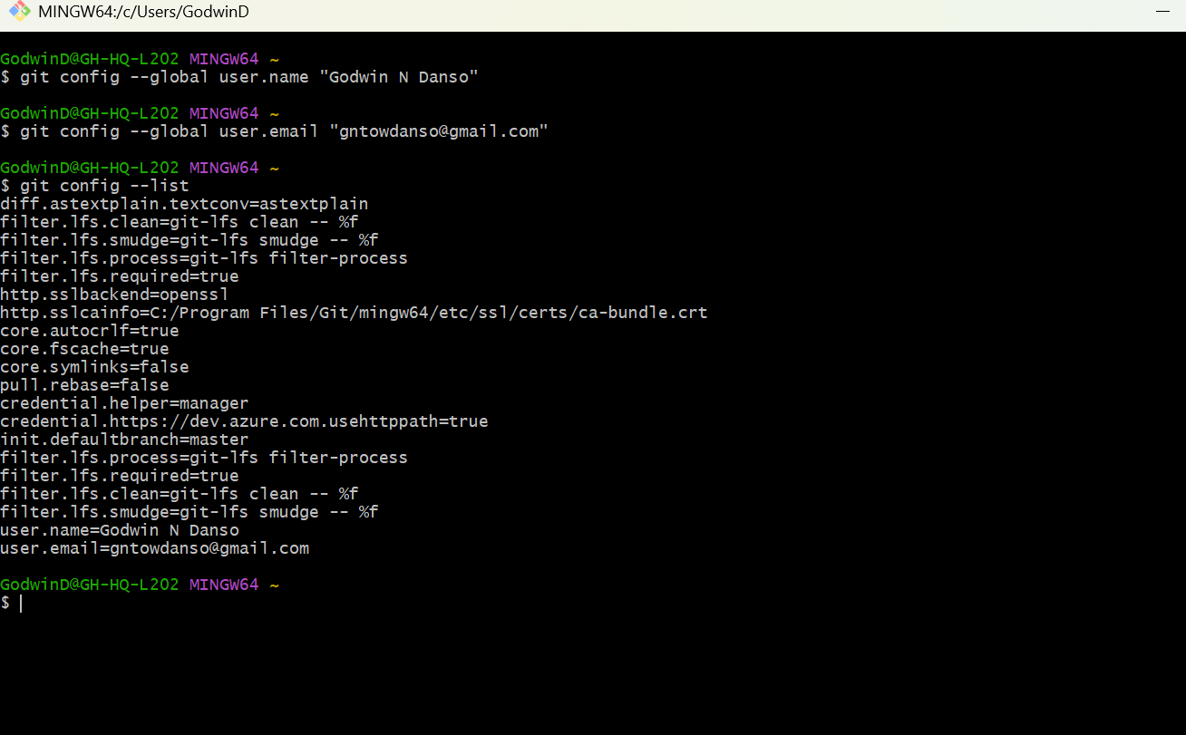
Configuring Git
Git config --list
Notes:
Use git config --global user.name and user.email to configure identity. These details appear in commit history.

Slide 16
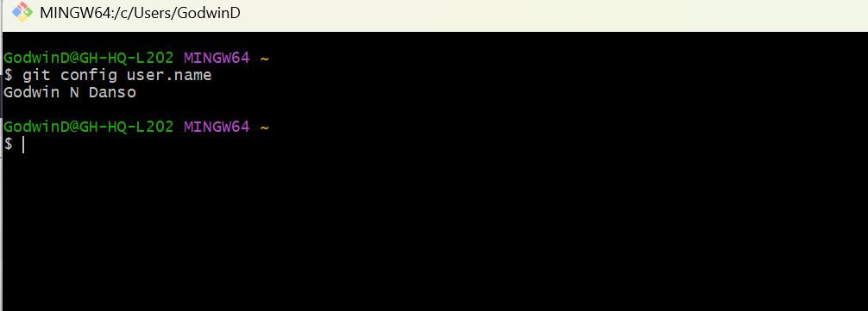
Configuring Git
View a Specific Setting
Use : Clear
to clear the screen
Notes:
Use git config --global user.name and user.email to configure identity. These details appear in commit history.

Slide 17
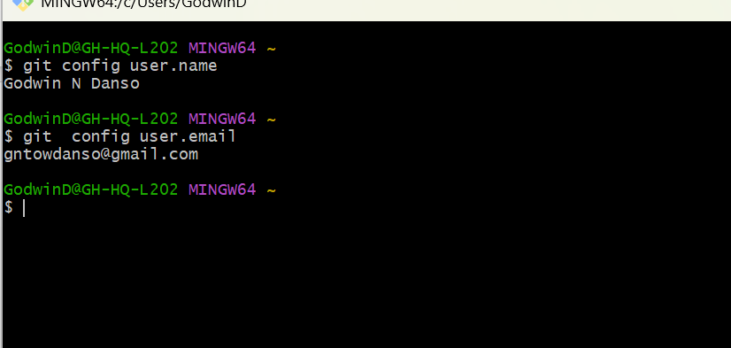
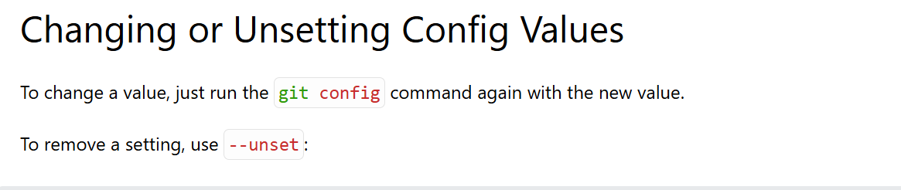
Configuring Git
Notes:
Use git config --global user.name and user.email to configure identity. These details appear in commit history.

Slide 18
Configuring Git
Configuration Levels
There are three levels of configuration:
System (all users): git config --system
Global (current user): git config --global
Local (current repo): git config --local
The order of precedence is:
Local (current repo)
Global (current user)
System (all users)
The reason to use the different levels is that you can set different values for different users or repositories.
This can be used for example to set different default branches for different repositories and users.
Notes:
Use git config --global user.name and user.email to configure identity. These details appear in commit history.

Slide 19
Configuring Git
Configuration Levels
Local = This project only
Global = Me (all my projects)
System = Everyone on this computer
System Level (All Users on the Computer)
git config --system
Global Level (Current User)
git config --global
Local Level (Current Repository Only)
git config --local
git config --local
Notes:
Use git config --global user.name and user.email to configure identity. These details appear in commit history.

Slide 20
Creating a Repository
Create or navigate to project folder
Run git init
Creates hidden .git directory
Repository is now tracked
Notes:
The git init command initializes a new repository. The .git folder stores all version history and metadata.

Slide 21
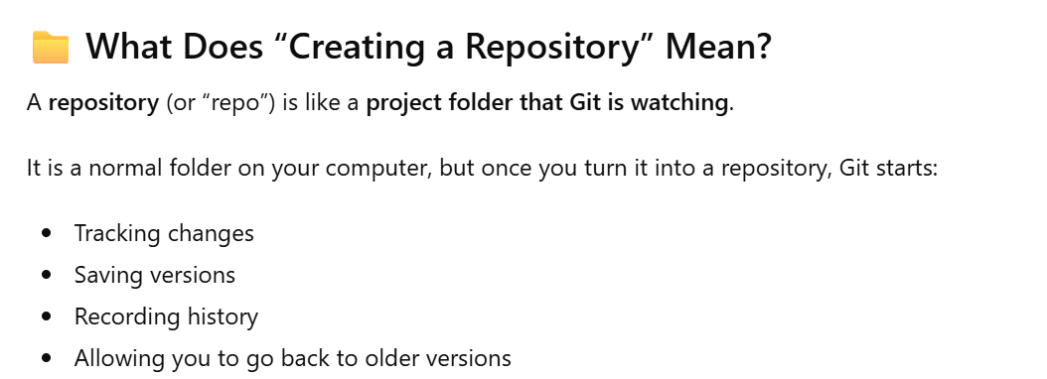
Creating a Repository
Notes:
The git init command initializes a new repository. The .git folder stores all version history and metadata.

Slide 22
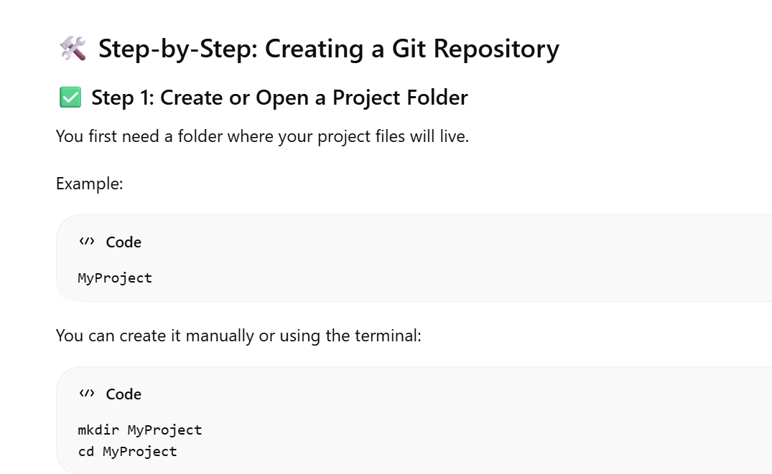
Creating a Repository
Notes:
The git init command initializes a new repository. The .git folder stores all version history and metadata.

Slide 23
Creating a Repository
Notes:
The git init command initializes a new repository. The .git folder stores all version history and metadata.

Slide 24
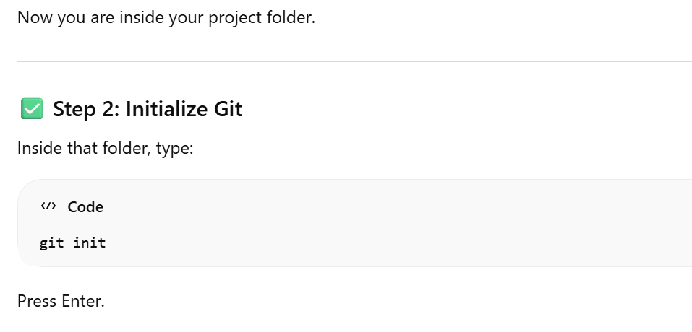
Creating a Repository
Notes:
The git init command initializes a new repository. The .git folder stores all version history and metadata.

Slide 25
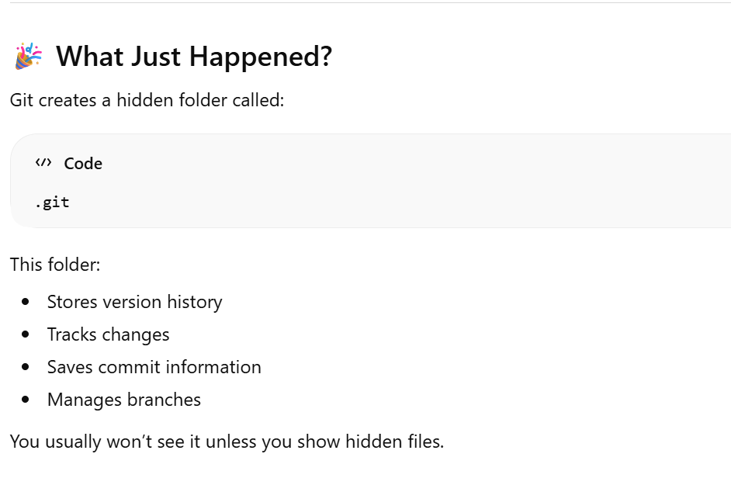
Creating a Repository
Notes:
The git init command initializes a new repository. The .git folder stores all version history and metadata.

Slide 26
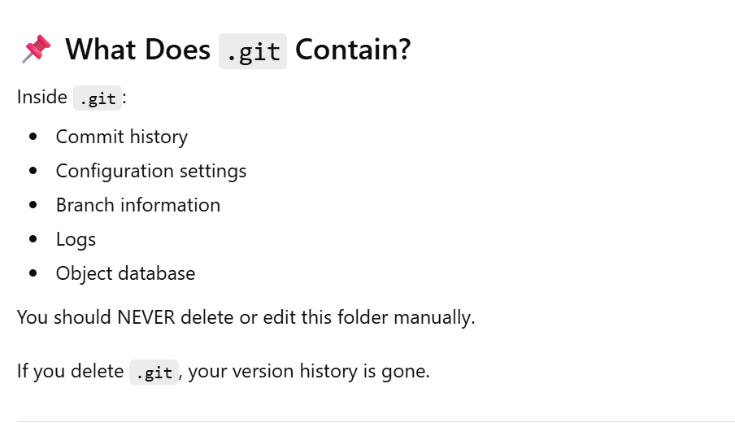
Creating a Repository
Notes:
The git init command initializes a new repository. The .git folder stores all version history and metadata.

Slide 27
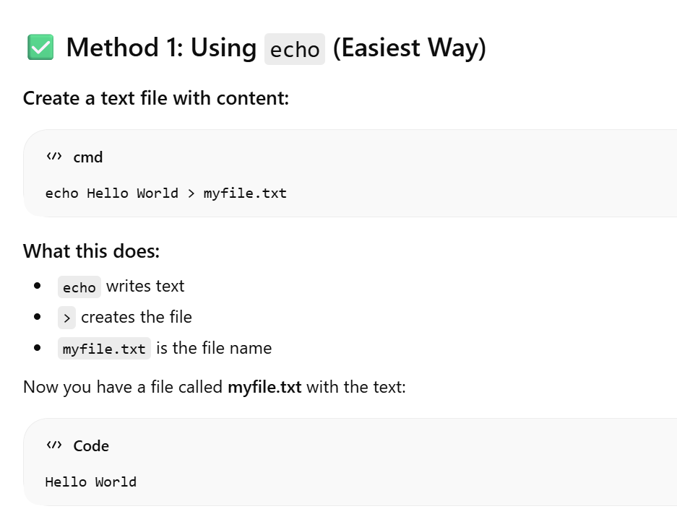
Creating a Repository
Notes:
The git init command initializes a new repository. The .git folder stores all version history and metadata.

Slide 28
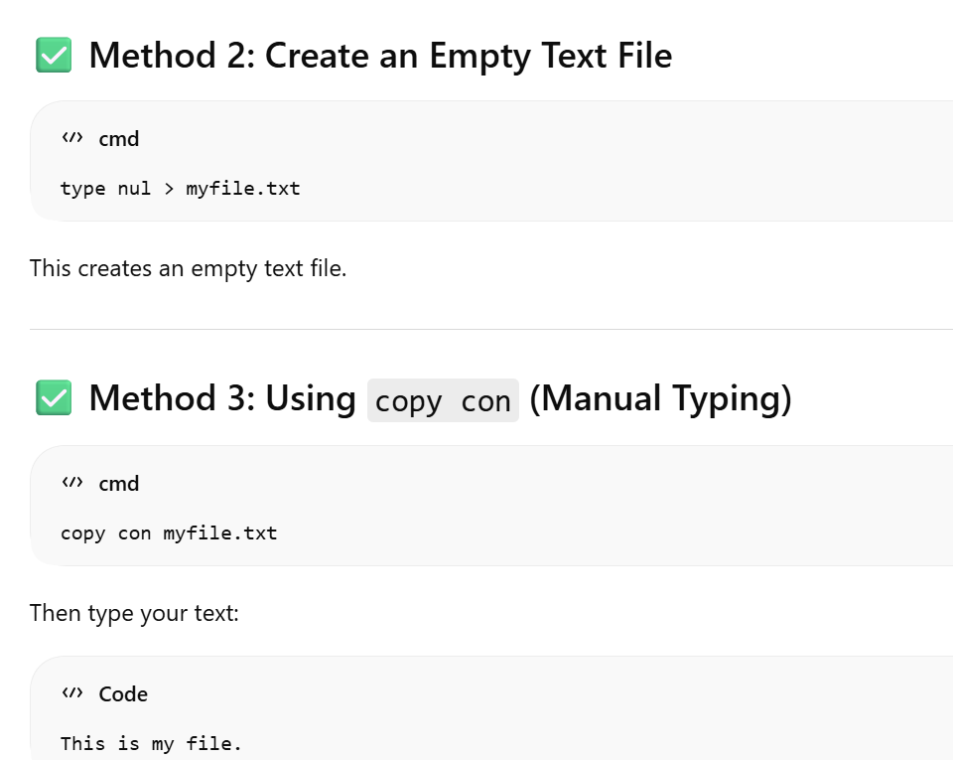
Creating a Repository
Notes:
The git init command initializes a new repository. The .git folder stores all version history and metadata.

Slide 29
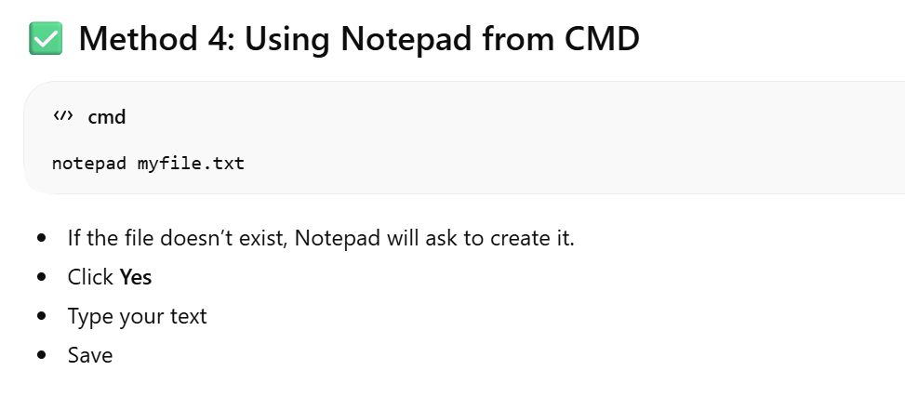
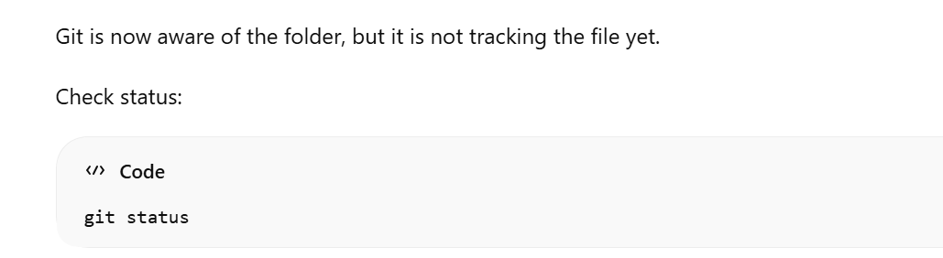
Creating a Repository
Notes:
The git init command initializes a new repository. The .git folder stores all version history and metadata.

Slide 30
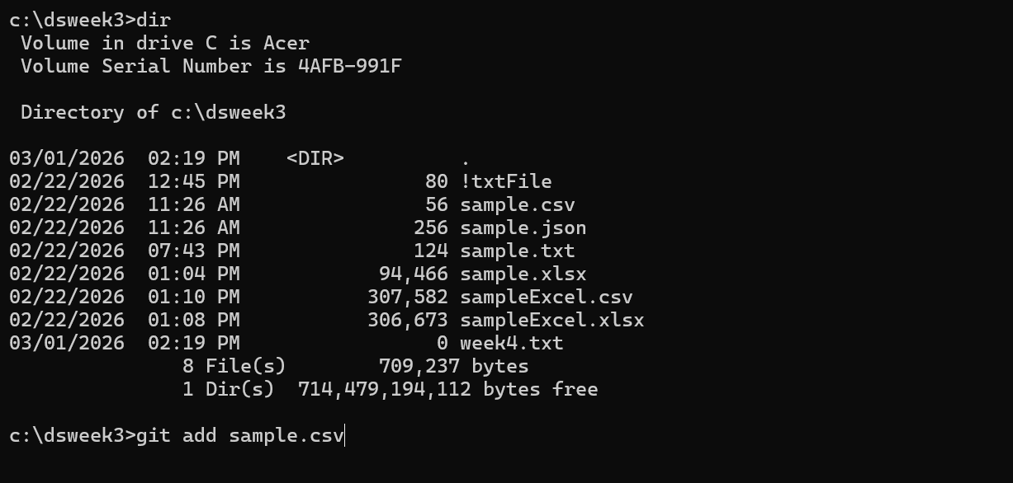
Adding files to a Repository
Step 1: Add the File
git add sample.csv
Notes:
The git init command initializes a new repository. The .git folder stores all version history and metadata.

Slide 31
Adding files to a Repository
Step 1: Add the File
git add sample.csv
Notes:
The git init command initializes a new repository. The .git folder stores all version history and metadata.

Slide 32
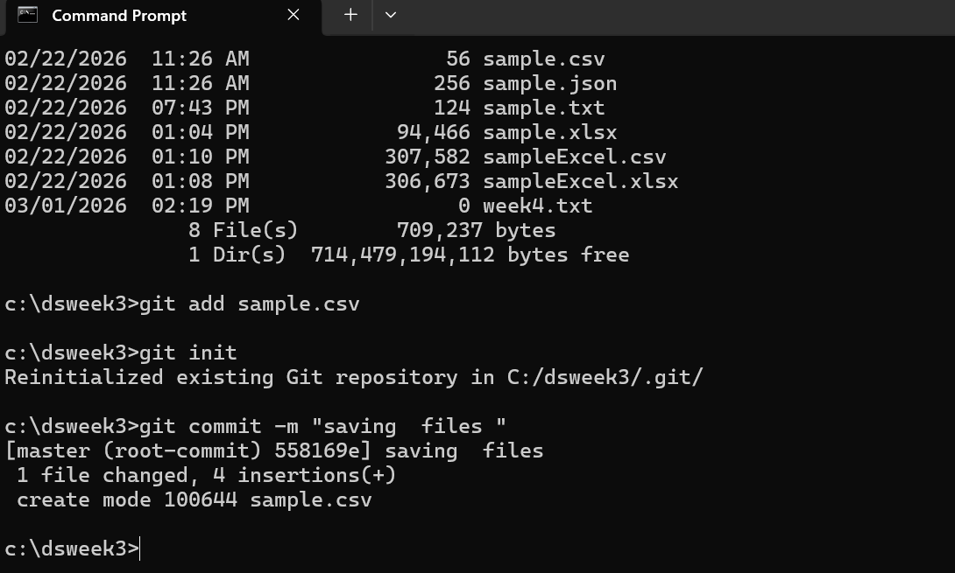
Adding files to a Repository
git commit -m "Initial commit"
Step 2: Commit the File
Now save it permanently:
Notes:
The git init command initializes a new repository. The .git folder stores all version history and metadata.

Slide 33
Adding files to a Repository
git commit -m "Initial commit"
Step 2: Commit the File
Now save it permanently:
Create folder
git init
Create files
git add
git commit
Notes:
The git init command initializes a new repository. The .git folder stores all version history and metadata.

Slide 34
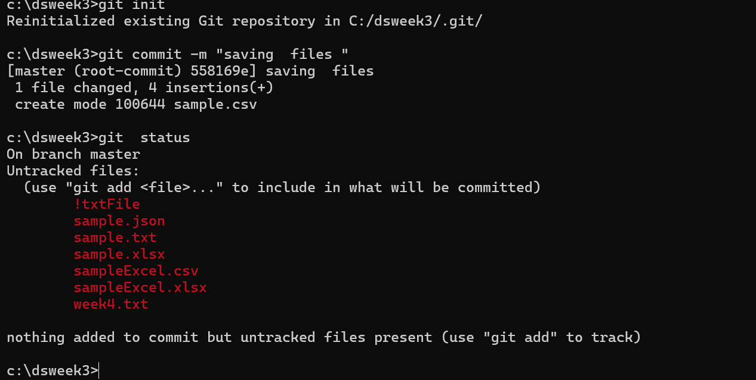
Checking the status
Notes:
The git init command initializes a new repository. The .git folder stores all version history and metadata.

Slide 35
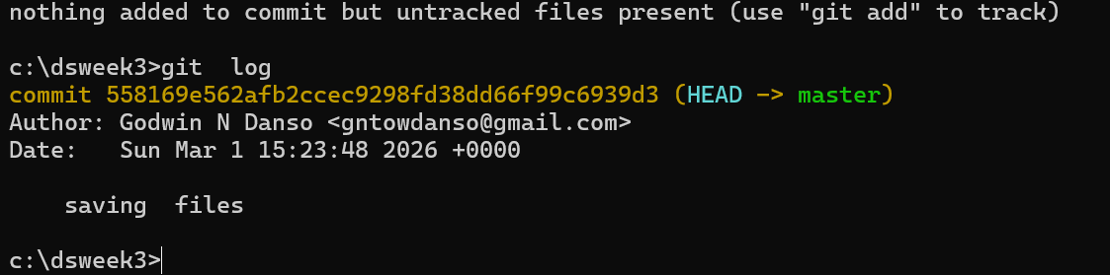
Checking the status
Short commit history | git log --oneline
Commit history | git log
Notes:
The git init command initializes a new repository. The .git folder stores all version history and metadata.

Slide 36
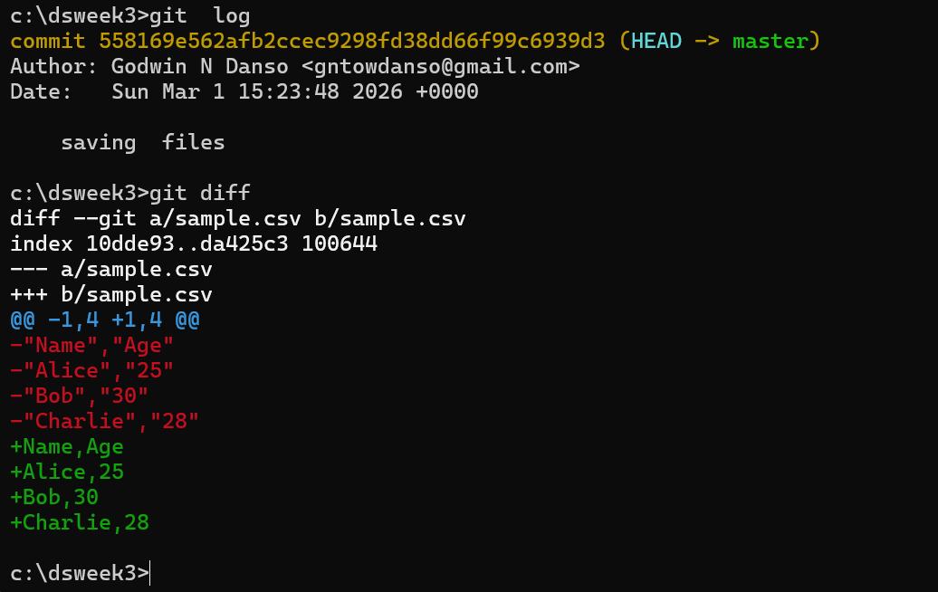
Checking the status
git diff
Notes:
The git init command initializes a new repository. The .git folder stores all version history and metadata.

Slide 37
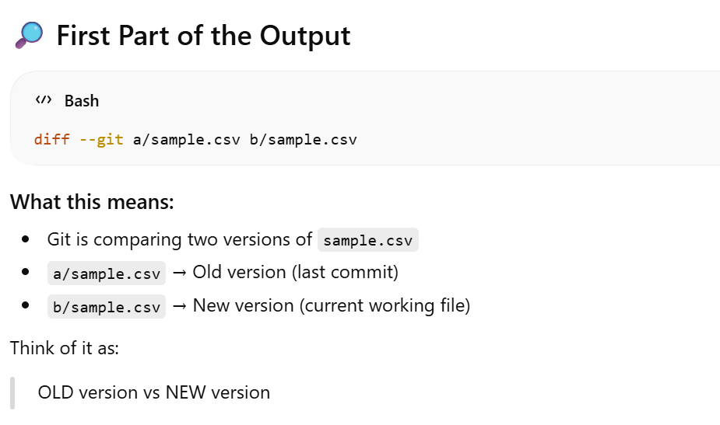
Checking the status
Notes:
The git init command initializes a new repository. The .git folder stores all version history and metadata.

Slide 38
Checking the status
Notes:
The git init command initializes a new repository. The .git folder stores all version history and metadata.

Slide 39
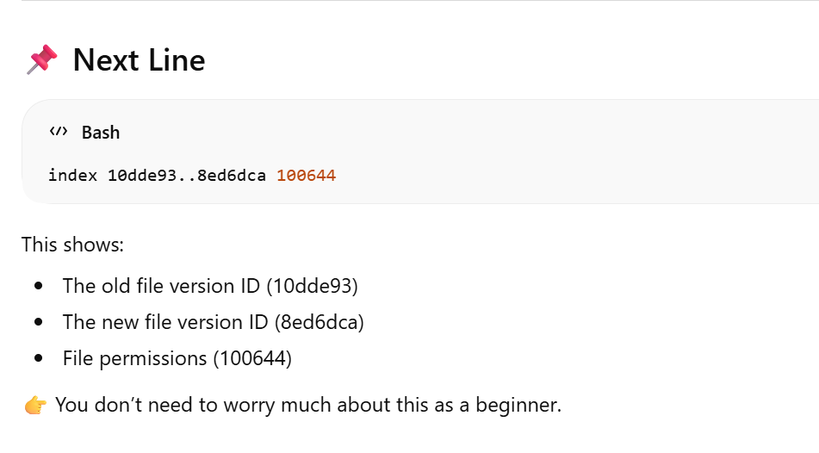
Checking the status
Notes:
The git init command initializes a new repository. The .git folder stores all version history and metadata.

Slide 40
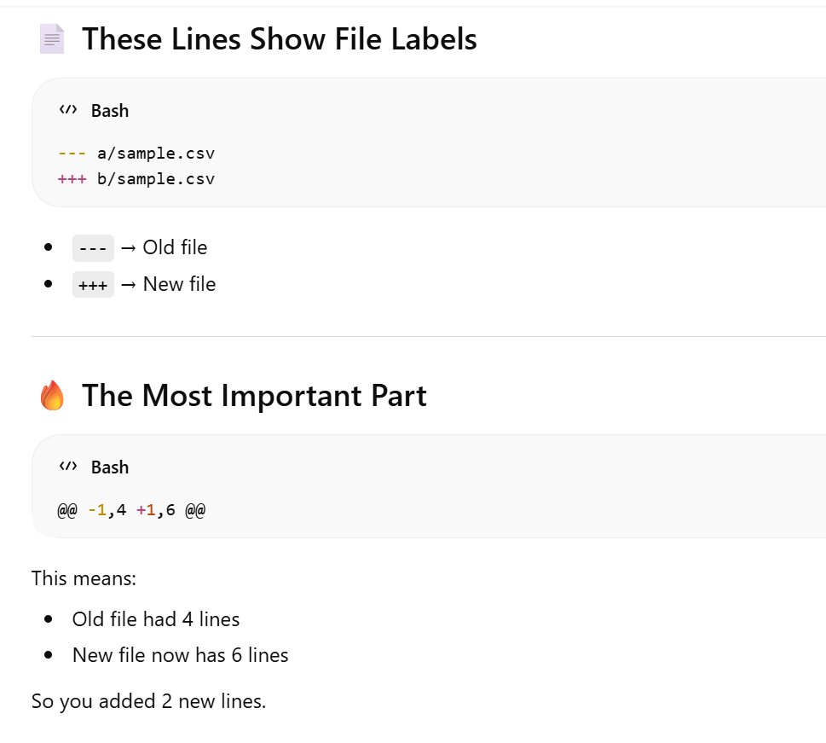
Checking the status
Notes:
The git init command initializes a new repository. The .git folder stores all version history and metadata.

Slide 41
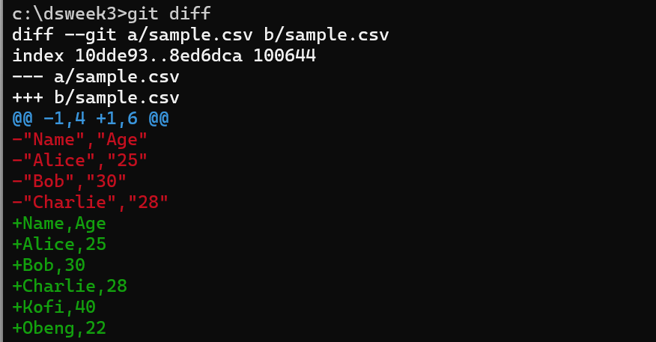
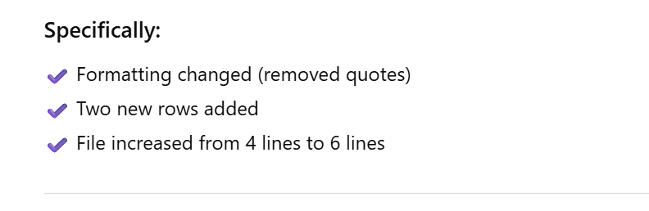
Checking the status
Notes:
The git init command initializes a new repository. The .git folder stores all version history and metadata.

Slide 42
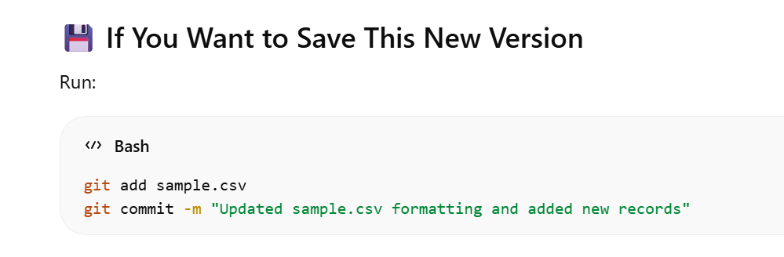
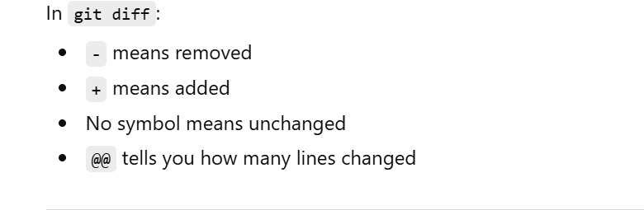
Checking the status
Notes:
The git init command initializes a new repository. The .git folder stores all version history and metadata.

Slide 43
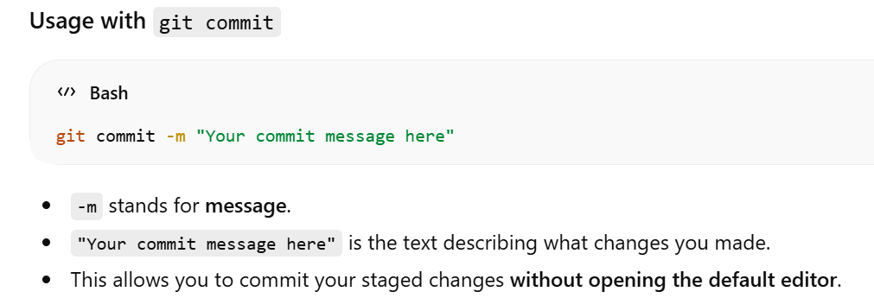
Checking the status
In Git, the -m option is commonly used with commands like git commit to provide a message directly from the command line, instead of opening an editor.
Notes:
The git init command initializes a new repository. The .git folder stores all version history and metadata.

Slide 44
resources
https://www.w3schools.com/git/default.asp?remote=github
Notes:
The git init command initializes a new repository. The .git folder stores all version history and metadata.

